Slide 1
Redox reactions grade 11

Slide 2
Oxidation-Reduction Reactions
•
•
oxidation-reduction reactions are also called redox reactions
all redox reactions involve the transfer of electrons from one atom to another
spontaneous redox reactions are generally exothermic, and we can use their released energy as a source of energy for other applications
•
Tro - Chapter 16
2

Slide 3
Development of oxidation and reduction reaction concept
Reaction of reduction oxidation based on releasing (lossing) and gaining of oxygen
  Oxidation reaction
Oxidation reaction is a reaction of gaining (capturing) of oxygen by a substance
Example :
^{CH}4(g) ^{+ 2O}2(g)
^{P}4(s) ^{+ 5O}2(g)
b. Reduction reaction Reduction reaction is oxide compound Example:
^{CO}2(g) ^{2P}2^{O}5(s)
+ 2H₂O_{g)}
a reaction of releasing (losing) of oxygen from a
CuO_{(s)}
^{Fe}2^{O}3(s)
^{+ H}2(g)
+ 3CO_{(g)}
^{Cu}(s) ^{+ H}2^{O}(g)
2Fe_{(s)} + 3CO_{2(g)}

Slide 4
Development of oxidation and reduction reaction concept
Reaction of reduction oxidation based on releasing (lossing) and gaining of oxygen
  Oxidation reaction
Oxidation reaction is a reaction of gaining (capturing) of oxygen by a substance
Example :
^{CH}4(g) ^{+ 2O}2(g)
^{P}4(s) ^{+ 5O}2(g)
b. Reduction reaction Reduction reaction is oxide compound Example:
^{CO}2(g) ^{2P}2^{O}5(s)
+ 2H₂O_{g)}
a reaction of releasing (lossing) of oxygen from a
CuO_{(s)}
^{Fe}2^{O}3(s)
^{+ H}2(g)
+ 3CO_{(g)}
^{Cu}(s) ^{+ H}2^{O}(g)
2Fe_{(s)} + 3CO_{2(g)}

Slide 5
What do you mean by oxidation and reduction ?
Oxidation can be defined as addition of oxygen/electronegative element to a substance or removal of hydrogen/ electropositive element from a substance.
Reduction can be defined as removal of oxygen/electronegative element from a substance or addition of hydrogen/ electropositive element to a substance.

Slide 6
Oxidation and ReductionAnother Def
in order to convert a free element into an ion, the atoms must gain or lose electrons
✓ of course, if one atom loses electrons, another must accept them
reactions where electrons are transferred from one atom to another are redox reactions
atoms that lose electrons are being oxidized, atoms that gain electrons are being reduced
2 Na(s) + Cl₂(g) → 2 Na⁺Cl–(s)
Na → Na⁺ + 1 e– Cl₂ + 2 e– → 2 Cl–
oxidation reduction

Slide 7
What is an oxidizing and reducing agent ?
Oxidising agent: a reagent which increases the oxidation number of an element of a given substance. These reagents are called oxidants.
Reducing agent: a reagent that lowers the oxidation number of a given element . These reagents are also called reductants.

Slide 8
Oxidation–Reduction
oxidation and reduction must occur simultaneously
✓if an atom loses electrons another atom must take them
the reactant that reduces an element in another reactant is called the reducing agent
✓the reducing agent contains the element that is oxidized
the reactant that oxidizes an element in another reactant is called the oxidizing agent
✓the oxidizing agent contains the element that is reduced
2 Na(s) + Cl₂(g) → 2 Na⁺Cl–(s) Na is oxidized, Cl is reduced
Na is the reducing agent, Cl₂ is the oxidizing agent

Slide 9
Oxidation and Reduction A Better Definition
oxidation occurs when an atom’s oxidation state increases during a reaction
reduction occurs when an atom’s oxidation state decreases during a reaction
CH₄ | + | 2 O₂ → | CO₂ + 2 H₂O
-4 +1 |  | 0 | +4 –2 +1 -2
oxidation
reduction

Slide 10
Will a Reaction Take Place?
reactions that are energetically favorable are said to be spontaneous
✓they can happen, but the activation energy may be so large that the rate is very slow
the relative reactivity of metals can be used to determine if some redox reactions are spontaneous

Slide 11
Electron transfer reactions
•
Place a strip of metallic zinc in an aqueous solution of copper nitrate , for about one hour. You may notice that the strip becomes coated with reddish metallic copper and the blue colour of the solution disappears. Formation of Zn2+ ions among the products can easily be judged when the blue colour of the solution due to Cu2+ has disappeared. If hydrogen sulphide gas is passed through the colourless solution containing Zn2+ ions, appearance of white zinc sulphide, ZnS can be seen on making the solution alkaline with ammonia.
The reaction between metallic zinc and the aqueous solution of copper nitrate is :-
•
•
In this reaction , zinc has lost electrons to form Zn2+and, therefore, zinc is oxidised. Evidently, now if zinc is oxidised, releasing electrons , copper ions is reduced by gaining electrons from zinc.

Slide 12
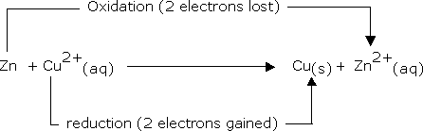
At this stage we may investigate the state of equilibrium for the reaction represented by equation . For this purpose, let us place a strip of metallic copper in a zinc sulphate solution. No visible reaction is noticed and attempt to detect the presence of Cu2+ ions by passing H2S gas through the solution to produce black colour cupric sulhpide. CuS, does not succeed. Cupric sulphide has such a low solubility that this is an extremely sensitive test. Cu2+ cannot be detected. Hence the equilibrium For the reaction favours the products over the reactants.

Slide 13
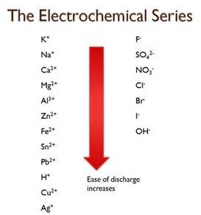
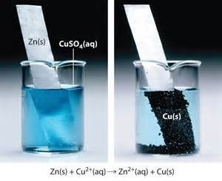
•
This suggests that we might develop a table in which metals and their ions are listed on the basis of their tendency to release electrons just as we do in the case of acids to indicate the strength of the acids. As a matter of fact we have already made certain comparisons. By comparison we have come to know that zinc releases electrons to copper and copper releases electrons to silver and therefore electron releasing tendency is in the order Zn>Cu>Ag .

Slide 14
2. Reduction oxidation reaction based on electron transfer
a. Oxidation reaction
Oxidation reaction is a reaction of electron releasing (lossing) from a substance. Example:
Na Mg Cu
Na⁺ + e⁻
_{Mg}2+
+ 2 e⁻
Cu²⁺ + 2 e⁻
b. Reduction reaction
Reduction reaction is a reaction of electron gaining by a substance.
Example:
Cl₂ + 2e⁻ 2Cl ⁻
S + 2 e⁻
_{S}2−

Slide 15
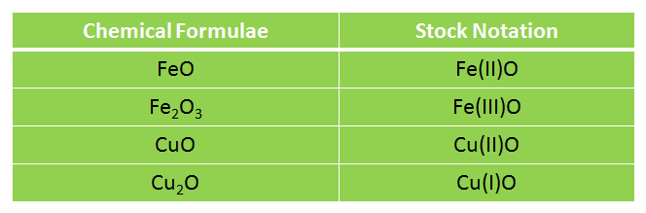
Stock notation
Stock notation is the notation used where the oxidation state of the element is represented by roman numerals.
Tro - Chapter 16
15

Slide 16
IUPAC Nomenclature
The compound that is formed by the elements have more than one type of oxidation number , its name diferentiated by the Roman number writing in the bracket in the back of that element name. The Roman number shows the value of oxidation number of that element.
The compound that is formed by the element only has one type of oxidation number, the Roman number does not need writen.
This IUPAC nomenclature applies in both ionic and covalent compounds.
Examples IUPAC name of binary covalent compound:
CO | : carbon(II) oxide | (oxidation number of C = +2)
CO₂ | : carbon(IV) oxide | (oxidation number of C = +4)
P₂O₃ | : phosphorus(III) oxide | (oxidation number of P = +3)
N₂O₅ | : nitrogen(V) oxide | (oxidation number of N = +5)
Cl₂O₇ | : chlorine(VII) oxide | (oxidation number of Cl = +7)

Slide 17
Oxidation state
For reactions that are not metal + nonmetal, or do not involve O₂, we need a method for determining
how the electrons are transferred
chemists assign a number to each element in a reaction called an oxidation state that allows them to determine the electron flow in the reaction
Basically oxidation number denotes the oxidation state of the element in a compound according to a set of rules formulated on the basis that electron fair in a covalent bond belongs entirely to the more electrovalent bond.
17

Slide 18
Oxidation Numbers
Oxidation is the loss of electrons; Reduction is the gain of electrons
Oxidation and reduction go together. Whenever a substance loses electrons and another substance gains electrons
Oxidation Numbers are a system that we can use to keep track of electron transfers

Slide 19

Common Oxidation States
Chemical species
Any element eg Fe, O₂ , S₈ Oxygen in any compound
Oxidation state and remarks
zero
-2 except in peroxides example H₂O₂ or Na₂O₂ then oxygen atom has oxidation state of -1 or in F₂O , then oxygen atom has oxidation state of +2
Fluorine in any compound
Hydrogen in any compound
-1 being most electronegative
+1 except in metal hydrides example NaH then hydrogen atom has oxidation state of -1 as metals have a greater tendency to lose electrons
Chlorine, bromine, iodine
-ve oxidation state if bonded to less electronegative element eg
NaCl; then Cl = -1.
+ve oxidation state if bonded to more electronegative element eg ClO⁻ , then Cl = +1; ClO₃⁻ , then Cl = +5

Slide 20
Oxidation Number
Oxdidation number is a number that states electrical charge possessed by each one element atom in the molecular compound or the ion.
In the molecules of ionic compound, electrical charge contained element atom can be raised by transfering of electrons.
In the formation of ionic bond:
-Metal atom losses electron to form the positive ion.
-Nonmetal atom gains electron to form the negative ion.
In the molecule of MgF₂, consist of Mg²⁺ ion with charge of 2+ dan F⁻ ion with
charge of 1−
Said that in the molecule of MgF₂, oxidation number of Mg is +2, and oxidation
number of F is -1.
In the molecule of covalent compound, the raising of the electrical charge each element atom is caused by its existence the difference of electronegativity of element, so that occur polarization covalent bond.
In the polar covalent compound, the more electronegative atom become more negative charge and the other atom become more positive charge.
In the polar covalent compound of H₂O, H contain 1+ and O contain 2−

Slide 21
Determining Oxidation Numbers of Elements
The oxidation number of an element in the molecule or in the ion, by use the rules of oxidation numbers can be determined.
Write down the molecular or ionic formula which will be determined oxidation number its element and between one atom of element and the others, given enough space.
Write each oxidation number of elements in below it and write x for element that will be determined its oxidation number.
Use the rules of oxidation number, that is rule of number 7 or 8, for determine x value.
Example:
Determine the following element oxidation number
a. S in molecule of H₂SO₄
2−
2 7
b. Cr in ion of Cr O
Given
: Molecule of H₂SO₄ Ion of Cr₂O₇²⁻
: a. oxidation number of S in H₂SO₄
Find
b. oxidation number of Cr in Cr₂O₇²⁻
Solution :

Slide 22
Rules for determining oxidation number
(1) In elements in the free or the uncombined state each atoms bears an oxidation number of zero.
(2)For ions composed of only 1 atom the oxidation number is equal to the charge on the ion.
(3)For oxygen in the case of superoxide's and peroxides oxidation state is assigned to oxygen as
-1 or –(½).
09/25/15
22

Slide 23
(4)The second exception with oxygen is with the fluorides and di-fluorides here the oxygen has an oxidation state of +2 and+1.
(5)The number assigned to oxygen will depend upon the bonding state of oxygen but this will have a positive number.
(6)the oxidation state of hydrogen is +1, except when it is bonded with elements with binary compounds. When it is bonded with lithium , beryllium it has the oxidation state of -1.

Slide 24
(7)In all its compounds fluorine has an oxidation state of -1.other halogens like chlorine , bromine and iodine have also the oxidation state as -1.except oxoanions and oxoacids.
(8)The algebraic sum of the oxidation number of all the atoms in a compound must be zero. In polyatomic ions the algebraic sum of all the oxidation numbers of atoms of the ion must be equal to the charge on the ion.

Slide 25
Oxidation Number basic Rules
Oxidation number of free elements
Free elements (include molecular elements: H₂, O₂, O₃, N₂, F₂, Cl₂, Br₂, I₂,
P₄, S₈) have oxidation number of 0 (zero).
Oxidation number of fluorine
In its compounds, oxidation number of F always –1.
Oxidation number of hydrogen
In its compounds, oxidation number of H always +1.
Except, hydrogen in the hydride compounds (compound of H with metal), oxidation number of H, is –1
Example:
In the compound of H₂O, NH₃, H₂S, HCl, HNO_{3,} H₂SO_{4,} oxidation
number of H, is +1
In the hydride compound, like LiH, NaH, MgH₂, oxidation number
of H, is –1

Slide 26
Rules for Assigning Oxidation States
5. in their compounds, nonmetals have oxidation states according to the table below
✓
nonmetals higher on the table take priority
Nonmetal | Oxidation State | Example
F | -1 | CF₄
H | +1 | CH₄
O | -2 | CO₂
Group 7A | -1 | CCl₄
Group 6A | -2 | CS₂
Group 5A | -3 | NH₃
 |  |  | 26

Slide 27
A. Reduction oxidation reaction based on oxidation number change
a. Oxidation reaction
Oxidation reaction is a chemical reaction which is accompanied by increasing of oxidation number.
Example:
_{Al}3+
^{Al}(s)
(aq)
^{S2-}(aq) ^{S}(s)
b. Reduction reaction
Reduction reaction is a chemical reaction which is accompanied by decreasing of oxidation number.
Example:
^{Sn4+}(aq) ^{Cl}2(g)
^{Sn2+}(aq) 2 Cl⁻
(g)

Slide 28
b. Generally, metallic elements of group B has oxidation number more than one type.
Example:
Table 8.1.
Oxidation numbers of several elements of group B
Elements of group B _{Oxidation numbers} Name Symbol
Zink | Zn | +2
Silver | Ag | +1
Copper | Cu | +1, +2
Gold | Au | +1, +3
Iron | Fe | +2, +3
Lead | Pb | +2, +4
6. Oxidation number of monoatomic ion
Oxidation number of mono atomic ions is equal to the charge on that ion
Example:
Na⁺ ion has oxidation number of +1 Ba²⁺ ion has oxidation number of +2 Fe³⁺ ion has oxidation number of +3 Cl⁻ ion has oxidation number of –1 S²⁻ ion has oxidation number of –2

Slide 29
The sum of oxidation number of element atoms in a compound molecule is equal to 0 (zero)
∑ o. n. of element in compound molecule = 0 Example: H₂O
(o.n. of H x 2) + (o.n. of O x 1) = 0
{(+1) x2} + {(-2) x 1} = 0
{+2} + {-2} = 0
The sum of oxidation number of element atoms in a polyatomic ion
is equal to the charge on that ion.
∑ o. n. of element in ion = charge of ion Example: OH⁻
(o.n. of O x 1) + (o.n. of H x 1) = -1
{(-2) x 1} + {(+1) x 1} = -1
{-2} + {+1} = -1

Slide 30
a. H₂SO₄
o. n. H = +1,
H₂
o. n. O = –2,
S O₄
o. n. S = x
+1 x –2
∑ o. n. element in molecule = 0
( 2 x o. n. H) + (1 x o.n. S) + (4 x o.n. O) = 0
{ 2 x (+1 ) } + { 1 x (x ) } + { 4 x (–2) = 0 ( +2) + (x) + (–8) = 0
x = +8 – 2  x = +6
□ The oxidation number of S in H₂SO₄ is +6
. Cr₂O₇
2−
o. n. O = –2,
o. n. Cr = x
₎2–
( Cr O
2 7
x –2
∑ o. n. of element in ion = charge of ion ( 2 x o. n. Cr ) + ( 7 x o.n. O ) = –2
{ 2 x (x) } + { 7 x (–2) } = –2
( 2x ) + ( –14 ) = –2  2x = +14 - 2
□ x =
+ 12
x = + 6
2
□ The oxidation number of Cr in CrO₄ is +6
2–

Slide 31

Example 1
−
+5Fe +8H ⎯⎯→Mn +5Fe
⁺² +2 +3
MnO
2+
+
2+
3+
+4H O
4
2
+7
Let the oxidation state of Mn be x.
Thus, in MnO₄⁻, x + 4(-2) = -1
x = +7
Manganese is reduced from oxidation state of
+7 in MnO₄⁻ to +2 in Mn²⁺, while iron is
oxidised from oxidation state of +2 in Fe²⁺ to
+3 in Fe³⁺.

Slide 32
Limitations of oxidation number
The main limitation of oxidation number is that oxidation number cannot be assigned a particular species.
The secondary limitation is that in recent past it has been found out that the oxidation process is visualized as a decrease in electron density and reduction process as an increase in electron density around the atom(s) involved in the reaction.
09/25/15
32

Slide 33
Paradox of fractional oxidation number
Sometimes we come across compounds having fractional oxidation number.
Examples C3O2 where carbon has the oxidation state of 4/3.
Br3O8 where bromine has a oxidation state of 16/3. Na2S4O6 where sodium has an oxidation state of 2.5 .

Slide 34
•
Fractional oxidation states are often used to represent the average oxidation states of several atoms of the same element in a structure.
Br3O8 has a oxidation state of 16/3 whereas it actually possess a oxidation state of +4 and +6.
Similarly thiosulphate ion exhibits oxidation state of +5 and 0 and hence the average or fractional oxidation state becomes 2.5.( in reality it possess +5 and +5 oxidation state )!
Similarly carbon suboxide experiences a fractional oxidation state of 4/3 whereas each carbon has a oxidation state of +2 and +2.
•
•
•

Slide 35
Redox Reaction
In the chemical reaction, oxidation reaction and reduction reaction always occur together, it is called oxidation reduction reaction abreviated as redox reaction.
In the redox reaction occurs transfering of electrons from the substance that undergo oxidation to the substance that undergo reduction. Therefore, redox reaction is also called reaction of transfering electrons
Special charateristic redox reaxtion is the oxidation number change.
 Oxidation
 Reduction
: lossing electron, increasing oxidation number.
: gaining electron, decreasing oxidation number.
The chemical reaction that does not espoused oxidation number change (increasing or decreasing in oxidation number) called non-redox reaction.

Slide 36
Example:
1. Redox reaction
Reaction of copper(II) oxide with hydrogen gas to form copper and water vapor
CuO_{(s)} + + (redox)
+2
^{H}2(g)
0
^{Cu}(s)
0
^{H}2^{O}(g)
+1
(red)
o. n. of Cu decreases from
+2 to 0
Changing in^{(o}o^{x}.n⁾. of Cu is –
2
o. n. of H increases from 0 to +1
Total changing in o.n. of H is +2
 In the redox reaction:
total number of increasing in oxidation number in oxidation
reaction = total number of decreasing in oxidation number
in
reduction reaction.

Slide 37
Example problem :
Given a redox reaction:
+ 2KClO_{3(s)} + 2KCl_{(s)}
^{3S}(s) ^{3SO}2(g)
Identify and under line, element atoms of reactants undergo change in oxidation number.
Determine the reactants that undergo reduction - oxidation include their product, and calculate its oxidation number change
Determine the reactant behaves as oxidant and reductant.
Answer:
  In the redox reaction:
^{3 S}(s)
0
+ 2 KClO_{3(s)}
(+5)
^{3 SO}2(g)
(+4)
+ 2 KCl_{(s)}
(-1)
Element atoms undergo change in oxidation number is:
S : oxidation number of S increases from 0 to +4
Cl : oxidation number of Cl element atom in KClO₃ decreases
from +5 to -1

Slide 38
b. In the redox reaction:
^{3 S}(s)
+ 2 KClO_{3(s)}
^{3 SO}2(g)
+
2 KCl_{(s)}
0
(+5)
(+4) (-1)
S is oxidized into SO₂
(0) (Ox)
(+12)
The total increasing o.n. of S (three atoms) is +12
(+10)KClO₃ is reduced into KCl
(Red) (-2)
The total decreasing o.n. of Cl (two atoms) is -12
c. In the redox reaction:
^{3 S}(s)
+ 2 KClO_{3(s)}
^{3 SO}2(g)
+ 2 KCl_{(s)}
0
(+5)
(+4)
S undergoes oxidation
The element of S is reducing agent
(-1)
KClO₃ undergoes reduction
The compound of KClO₃ is oxidizing agent

Slide 39
Types of redox reactions
There are 5 types of redox reactions :- Combination reactions
Decomposition reaction Displacement reactions Double displacement reactions Disproportion reactions
39

Slide 40
Non-redox reactions
The oxidation states of the elements remained unchanged in the following reactions:
Neutralisation reactions:
NaOH + HCl ⎯⎯→ NaCl + H ₂O
CuO + H ₂ SO₄ ⎯⎯→CuSO₄ + H ₂O

Slide 41
Non-redox reactions
The oxidation states of the elements remained unchanged in the following reactions:
Precipitation reactions:
2NaOH _{(aq)} ⎯⎯→Cu(OH )_{2( s)}
^{CuSO}4(aq ) ^{+ Na}2 ^{SO}4(aq)
^{2KI}(aq )
+ Pb(NO₃ )_{2(aq)} ⎯⎯→ PbI_{2( s )} + 2KNO_{3(aq )}

Slide 42
Non-redox reactions
The oxidation states of the elements remained unchanged in the following reactions:
Complex formation:
⎯⎯→[Cu( NH ) ]
2+ (aq)
Cu ²⁺ (aq)
4NH
ligand
3(aq ) 3
4
Tetraammine copper(II) complex (deep blue solution)

Slide 43
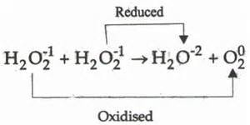
Disproportionation reactions
•
These are a special type of reactions where an element in one oxidation state is simultaneously oxidised and reduced.
One of the reacting substances in a disproportion reaction always contains an element that can exist in at least 3 oxidation states.
The element in the form of reacting substance is in the intermediate oxidation state.
•
•

Slide 44
Hypochlorite ion formed in a disproportion reaction oxidises the colour bearing stains of the substances to colourless compounds.
Fluorine is the most electronegative element and hence it cannot exhibit any positive oxidation state.
Fluorine does not show a disproportion tendency.

Slide 45
Auto Redox Reaction (Disproportionation)
Auto redox reaction is a reaction of reduction and oxidation that occur in the same substance (reactant).
Example of auto redox reaction:
Reaction of chlorine gas with sodium hydroxide solution
^{Cl}2(g)
0
+ 2 NaOH_{(aq)}
Na Cl_{(aq)} + Na Cl O_{(aq)}
–1 +1
^{+ H}2^{O}(l)
(reduction)
o. n. of Cl decreases from 0 into –1
(oxidation)
o. n. of Cl increases from 0 into + 1

Slide 46
Disproportionation Reaction
•
Example:
Is this a disproportionation reaction?
NH ₄ NO₃ ⎯⎯→ N₂O + 2H ₂O
-3 +5 +1
This is NOT a disproportionation reaction
Disproportionation requires that the same atom is both oxidised and reduced simultaneously.
In this case, different atoms (of nitrogen) are oxidised and reduced.

Slide 47
A Special Redox reaction:
_{Example} Disproportionation
Is it possible
Chlorine is simultaneously reduced from oxidation state of 0 in Cl₂ to -1 in Cl⁻, and oxidised from oxidation state of 0 in Cl₂ to +1 in ClO⁻.
− − −
Cl₂ +2OH ⎯⎯→ClO +Cl +H ₂O
+1 -1
0

Slide 48
Balancing Redox Reactions thorugh half reaction method
There are several basic steps
Assign oxidation numbers to the species in the reaction
Find the substance oxidized and the substance reduced
Write half reactions for the oxidation and reduction
Balance the atoms that change in the half reaction
Determine the electrons transferred and balance the electrons between the half reactions
Combine the half reactions and balance the remaining atoms
Check your work. Make sure that both the atoms and charges balance

Slide 49
Identify the Oxidizing and Reducing Agents in Each of the Following
3 H₂S + 2 NO₃– + 2 H⁺ → 3 S + 2 NO + 4 H₂O
MnO₂ + 4 HBr → MnBr₂ + Br₂ + 2 H₂O

Slide 50
Identify the Oxidizing and Reducing Agents in Each of the Following
red ag ox ag
3 H₂S + 2 NO₃– + 2 H⁺ → 3 S + 2 NO + 4 H₂O
+1 -2 +5 -2 +1 0 +2 -2 +1 -2
oxidation
reduction
ox ag
red ag
MnO₂ + 4 HBr → MnBr₂ + Br₂ + 2 H₂O
+4 -2 +1 -1 +2 -1 0 +1 -2
oxidation
reduction

Slide 51
Balancing Redox Reactions
assign oxidation states and determine element oxidized and element reduced
separate into oxidation & reduction half-reactions
balance half-reactions by mass
  first balance atoms other than O and H
  then balance O by adding H₂O to side that lacks O
  finally balance H by adding H⁺ to side that lacks H
Fe²⁺ + MnO₄– → Fe³⁺ + Mn²⁺
+2 +7 -2 +3 +2
oxid
red
Fe²⁺ → Fe³⁺ MnO₄– → Mn²⁺
Fe²⁺ → Fe³⁺ MnO₄– → Mn²⁺
MnO – → Mn²⁺ + 4H O
4 2
MnO – + 8H⁺ → Mn²⁺ + 4H O
4 2

Slide 52
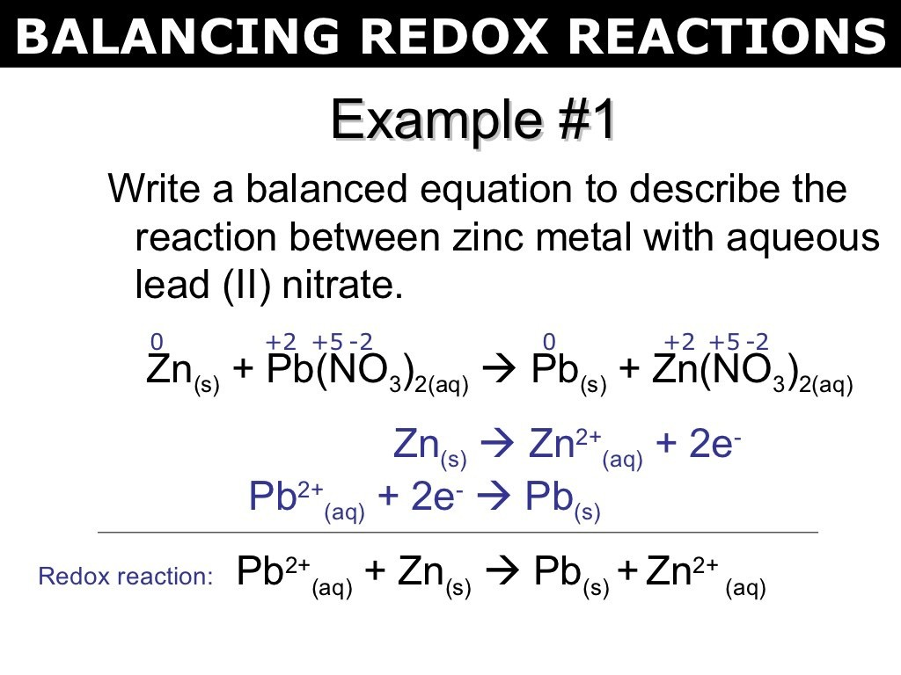
Balancing Redox Reactions
4) balance each half-reaction
with respect to charge by adjusting the numbers of electrons
Fe²⁺ → Fe³⁺ + 1 e⁻
MnO₄ + 8H → Mn + 4H₂O
– + 2+
+7 +2
MnO + 8H + 5 e → Mn
+ 4H O
electrons on product side for oxid.
electrons on reactant side for red.
– + -
2+
4
2
balance electrons between half-reactions
add half-reactions, canceling electrons and common species
Fe²⁺ → Fe³⁺ + 1 e⁻
} x 5
MnO – + 8H⁺ + 5 e⁻ → Mn²⁺ + 4H O
4 2
5 Fe²⁺ → 5 Fe³⁺ + 5 e⁻
MnO – + 8H⁺ + 5 e⁻ → Mn²⁺ + 4H O
4 2
6) Check
5 Fe²⁺ + MnO₄ + 8H → Mn + 4H₂O + 5 Fe
– + 2+ 3+

Slide 53
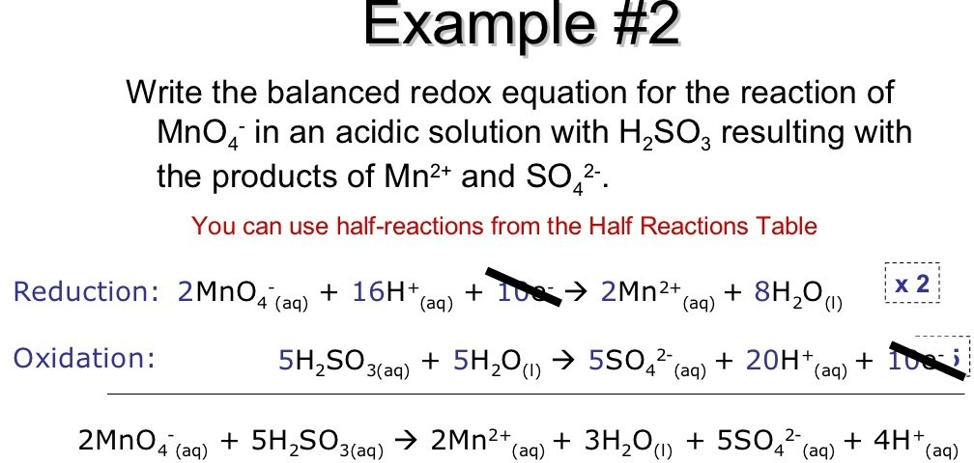
Tro - Chapter 16

Slide 54
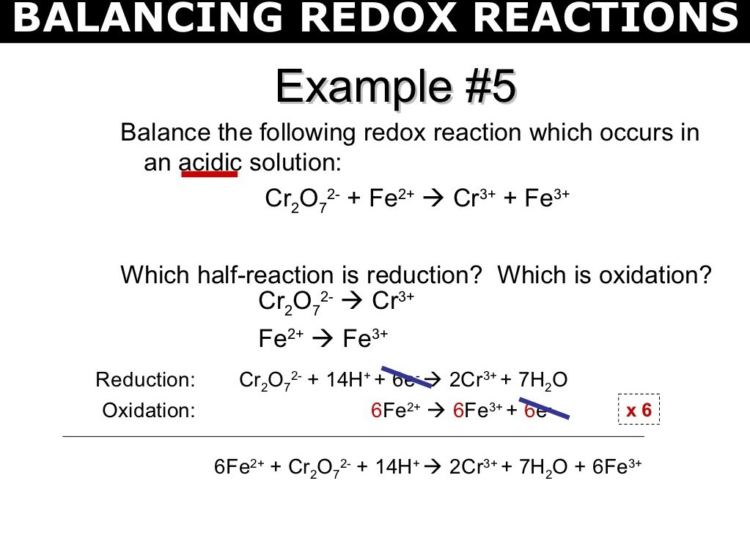
Tro - Chapter 16

Slide 55
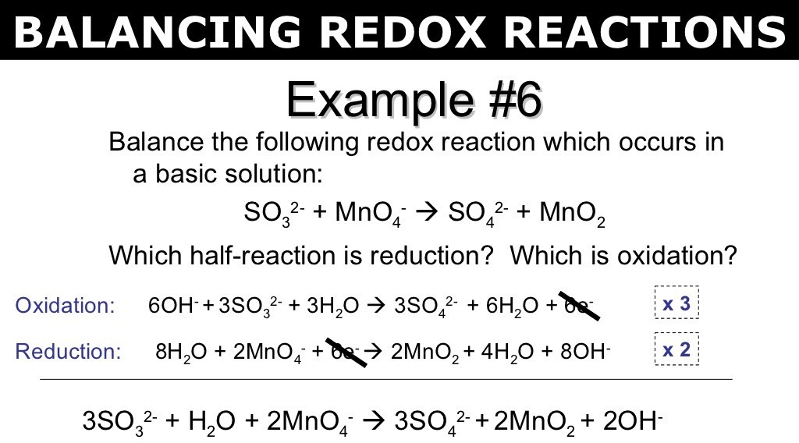
Tro - Chapter 16

Slide 56
Redox reactions as the basis for titrations
In one situation, the reagent itself is intensely coloured. Here in this case the permanganate ion it acts as a self indicatorhere the end point is reached after the vlast of the reductant is oxidised and the first lasting tinge of pink colour appears at low concentration.
This ensures minimal overshoot in colour beyond the equivalence point , the point where the reductant and the oxidant are equal in terms of their mole stoichiometry.
if there is no dramatic auto-colour change there are indicators which are oxidised immediately after the last bit of the reactant is consumed, producing a dramatic colour change. The best example is afforded by
Dichromate salt , which is not a self indicator, but oxidises the indicator substance diphenylamine just after the equivalence point to produce an intense blue colour, thus signaling the end point.
There is yet another method which is interesting and quite
56
common. Its use is restricted to those reagents which are able to

Slide 57
For example,
This method relies on the facts iodine gives an intense blue colour starch and has very specific reaction with thiosuphate ion which is too a redox reaction.
Iodide remains a solution containing KI or KI3
On addition of starch after the liberation of iodide from the reaction of Cu 2+ ions on iodide ions , an intense blue colour appears , this colour disappears as soon as iodine is consumed by thiosuphate ions . Thus the end point can be tracked easily by stoichiometric calculations
57

Slide 58
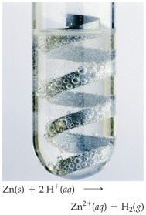
Activity Series of Metals
displace H₂
K
Ba Sr
Ca Na
Mg
Al Mn Zn Cr Fe Cd Co Ni Sn Pb H
Sb As
Bi Cu
Hg
Ag Pd Pt Au
from cold H₂O
listing of metals by reactivity
free metal higher on the list displaces metal cation lower on the list
metals above H will dissolve in acid
Zn + Fe²⁺ → Fe + Zn²⁺
Cu + Fe²⁺ → no reaction Zn + 2 H⁺ → H₂ + Zn²⁺
Fe is below Zn, so Zn metal will displace Fe²⁺
react with O₂ in the air to make oxides
react with O₂ in the air to make oxides
from steam
from acids
58

Slide 59
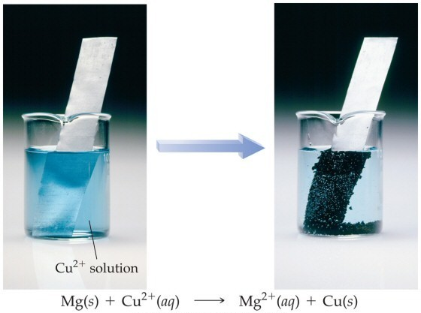
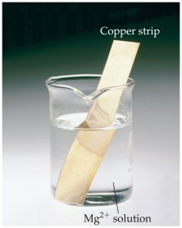
Mg is above Cu on the Activity Series
Mg will react with Cu²⁺ to form Mg²⁺ and Cu metal
but Cu will not react with Mg²⁺

Slide 60
Electrochemical Cells
electrochemistry is the study of redox reactions that produce or require an electric current
the conversion between chemical energy and electrical energy is carried out in an electrochemical cell
spontaneous redox reactions take place in a voltaic cell
✓also known as galvanic cells
✓batteries are voltaic cells
nonspontaneous redox reactions can be made to occur in an electrolytic cell by the addition of electrical energy

Slide 61
Electrodes
Anode
✓electrode where oxidation occurs
✓anions attracted to it
✓connected to positive end of battery in electrolytic cell
✓loses weight in electrolytic cell
Cathode
✓electrode where reduction occurs
✓cations attracted to it
✓connected to negative end of battery in electrolytic cell
✓gains weight in electrolytic cell
➢electrode where plating takes place in electroplating

Slide 62
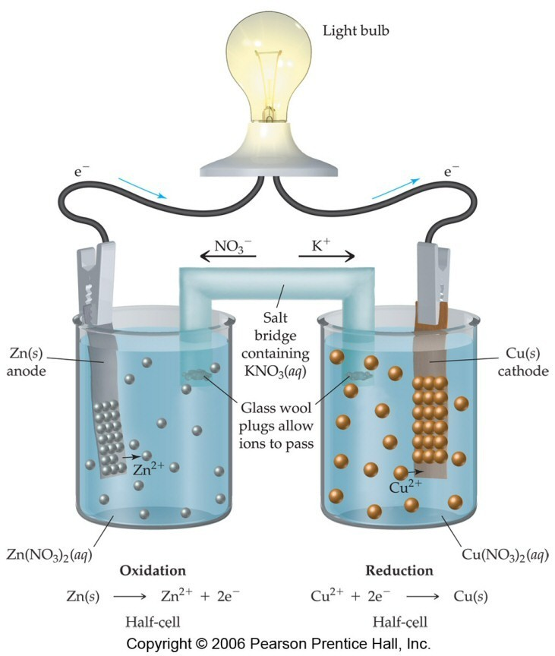
Voltaic Cell
Tro - Chapter 16
62

Slide 63
Redox reactions and electrode process
Redox couple:-
It is defined as having together the oxidised and reduced forms of a substance taking part in an oxidation or reduction half reaction
This is represented by separating the oxidised form from the reduced form by a vertical line showing for e.g. solid/solution interface.

Slide 64
Example:- Zn²⁺/Zn ,Cu²⁺/Cu.
In both cases oxidised form is put before the reduced form.
Experiment-daniell’s cell
Now we put the beaker containing copper sulphate solution and the beaker containing zinc sulphate solution side by side . We connect solutions in two beakers by a salt bridge (a U-tube containing a solution of potassium chloride or ammonium nitrate usually solidified by boiling with agar agar and later cooling to a jelly like substance.)
This provides an electric contact between the two solutions without allowing them to mix with each other. The zinc and copper rods are connected by a metallic wire with a provision for an ammeter and a switch. The set-up is known as Daniell cell. When the switch is in the o position, no reaction takes place in either of the beakers and no current flows through the metallic wire.

Slide 65
As soon as the switch is on we get the following observations:-
The transfer of electrons now does not take place directly from Zn to Cu²⁺ but through the metallic wire connecting the two rods as is apparent from the arrow which indicates the flow of current.
The electricity from solution in one beaker to solution in the other beaker flows by the migration of ions through the salt bridge. We know that the flow of current is possible only if there is a potential difference between the copper and zinc rods known as electrodes here.

Slide 66
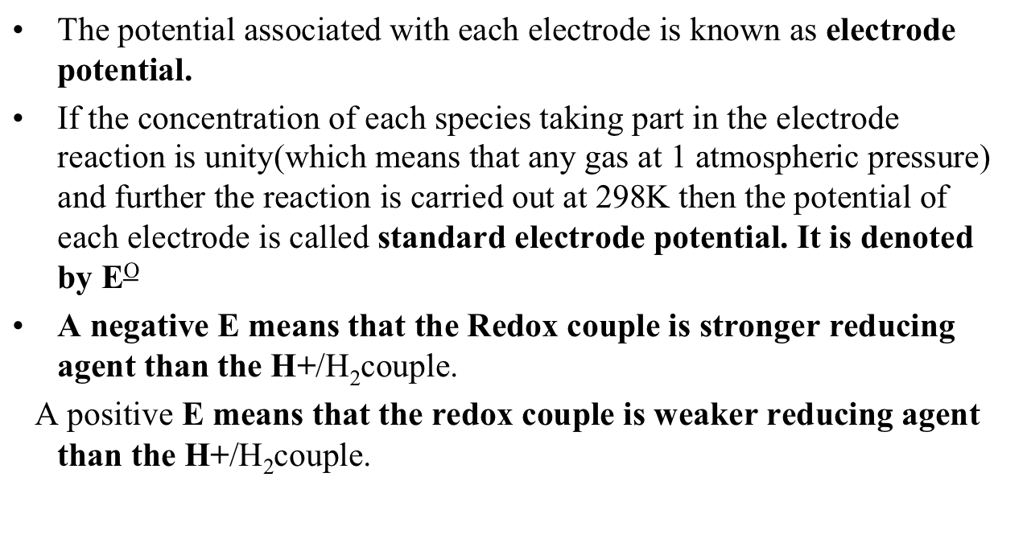
Standard electrode potential

Slide 67



Types of Electrochemical Cells
Voltaic (or galvanic) cell: uses a spontaneous reaction (∆G < 0) to generate electrical energy.
Electrolytic cell: uses electrical energy to drive a non-spontaneous reaction (∆G > 0).
Contain two electrodes (anode and cathode) dipped into an
aqueous electrolyte solution.
The oxidation half-reaction occurs at the anode; the reduction half-reaction occurs at the cathode.

Slide 68
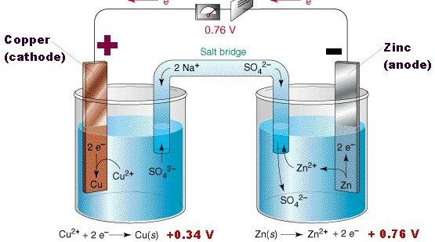
Daniel's cell setup
68

Slide 69
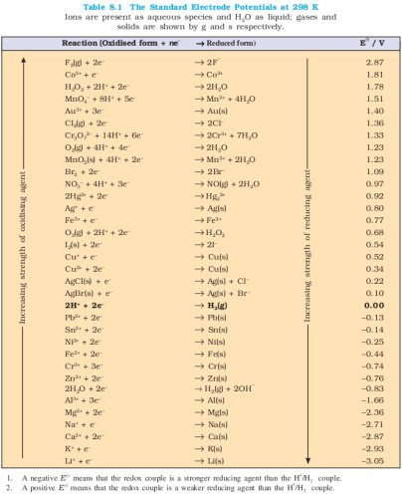
09/25/15
69

